Slide 1
Aircraft Data Logger
IIB Project – Michaelmas Presentation

Slide 2
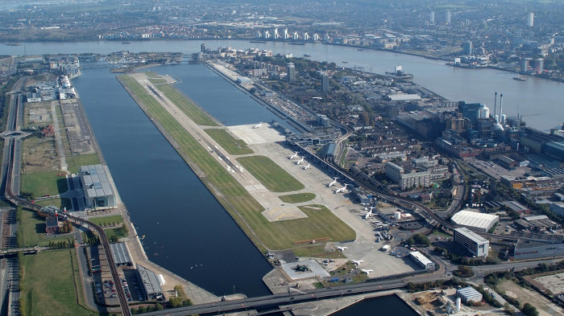
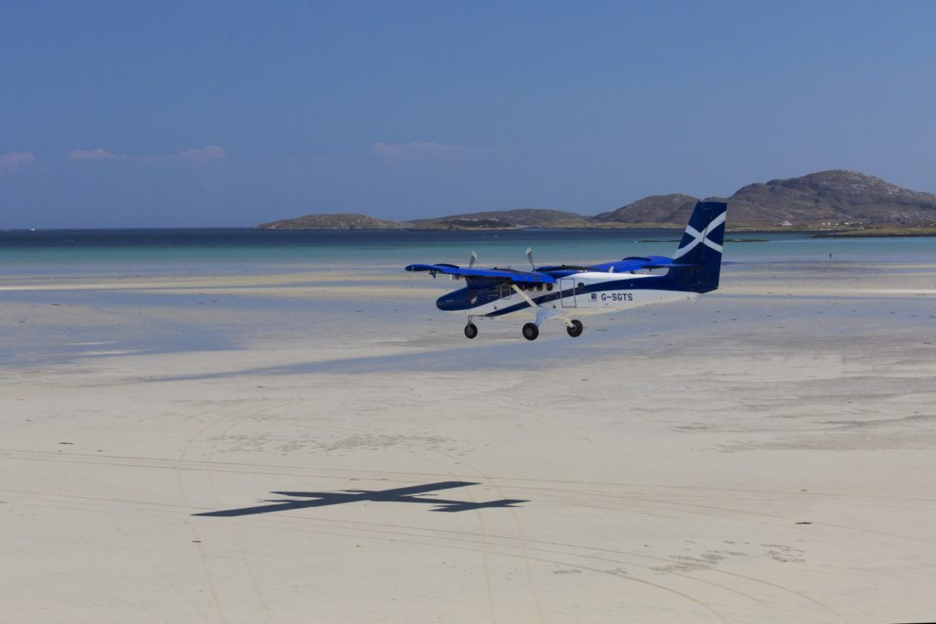
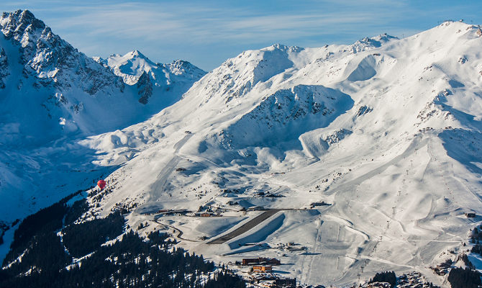
Can you land here?
London City Airport (LYC): 1,508m
Barra Airport (BRR): 680,799,846m
Sand
Tide
Courchevel-670 (CVF) : 537m
At altitude
Mountains
18% gradient

Slide 3
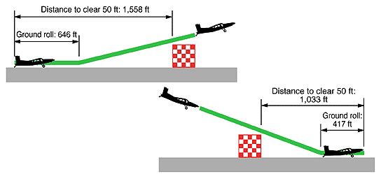
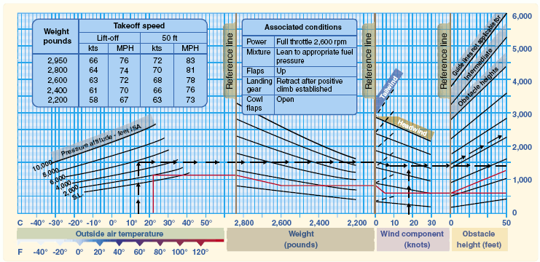
Take-off and landing parameters
Paraments we need:
Ground Roll – Distance to take off/land
Distance to clear 50ft (15.2m) – Get over obstacles, ensure great enough climb rate
Depend on:
Pressure
Temperature
Weight
Windspeed
Runway surface etc etc
Determine from Performance charts or tables:
Given conditions, how far do I need?

Slide 4
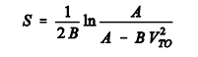
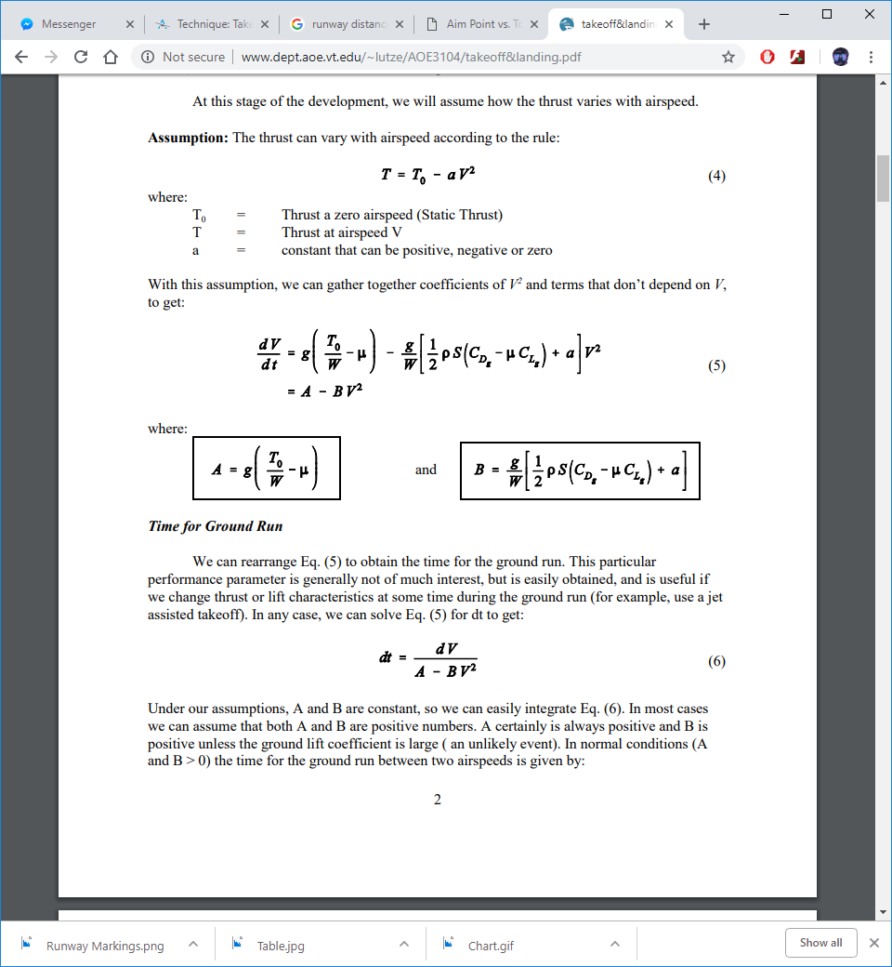
Method 1: Calculation
Method
Take all your parameters, conditions and equations of motion and crunch through it
Advantages
Simple, cheap
Can be implemented in software
Drawbacks
Laborious, time consuming
Model gets more complex the more parameters there are

Slide 5
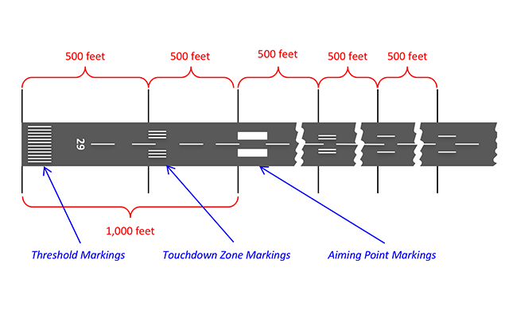
Method 2: “By-eye”
Method
Plane has all the instruments, runways have distance markings, just judge it while you take off
Advantages
The simplest bar far
No special equipment or complex calculation required
Drawbacks
Not very accurate
Another thing for the test pilot to be worrying about

Slide 6
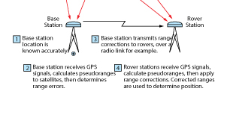
Method 3: Differential GPS
Method
Using a GPS base station that has a known, fixed location, correct the errors from the aircrafts GPS to get a accurate reading of distance. Use the altimeter to get distance to clear 50ft.
Advantages
Most accurate method
Many airports already have base stations
Drawbacks
DGPS-capable modules are very expensive

Slide 7
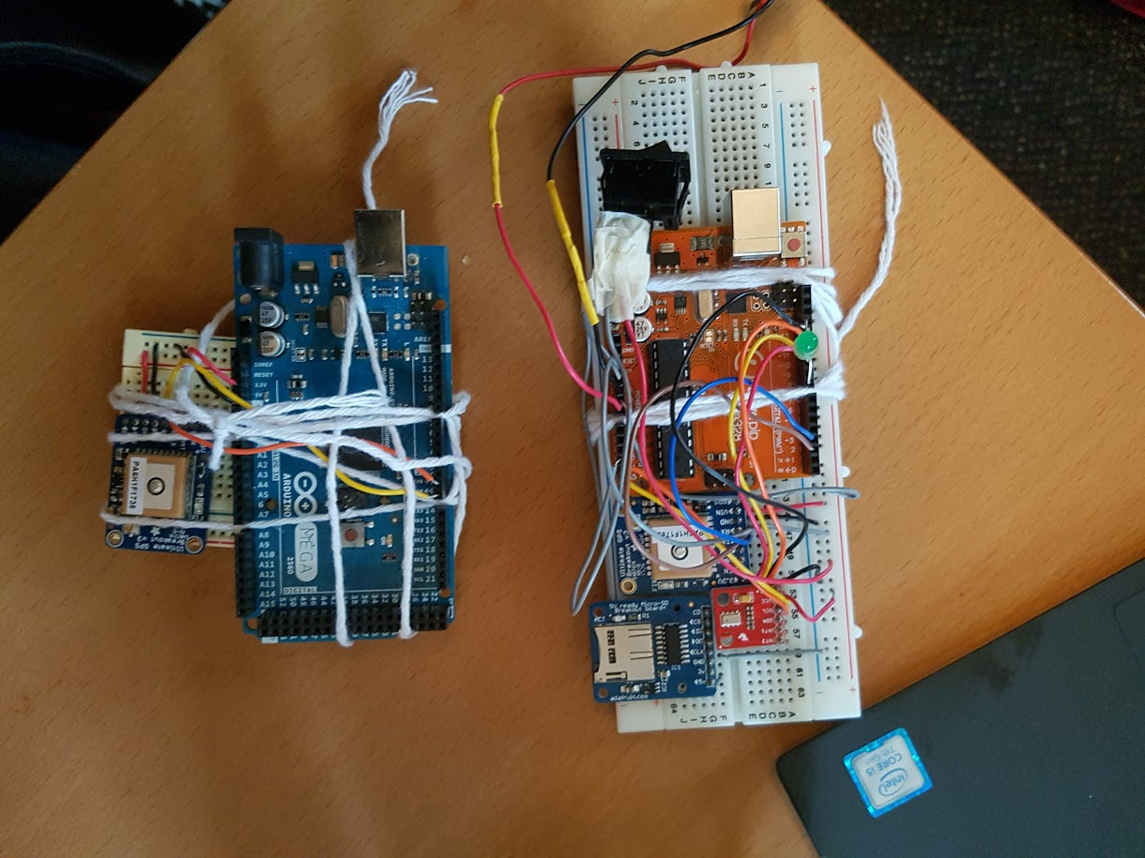
Goal of Project
Goal “Create a cheap module that can measure accurately ground roll, distance to clear 50ft and distance to descend 50ft for aircraft”
Requirements:
~10Hz data acquisition rate
Get altitude to within 1ft (30cm)
Get distance to within 3ft (1m)
Cheap, small, easy to use module
Post-processing saved data allowed, but real time results desirable

Slide 8
Plan
Michaelmas – Proof of concept
Lent – Design, Build, Test
Characters GPS and pressure sensor
Explore ways to make GPS readings more accurate
Decide on method of measuring distance and altitude going forward
Choose method of controlling electronics
Choose data processing method
Design PCB
Assembly PCB and module
Program microcontroller
Test module (department aircraft)
Easter – Wrap up
Further improvements
Screen
Telemetry
Report

Slide 9
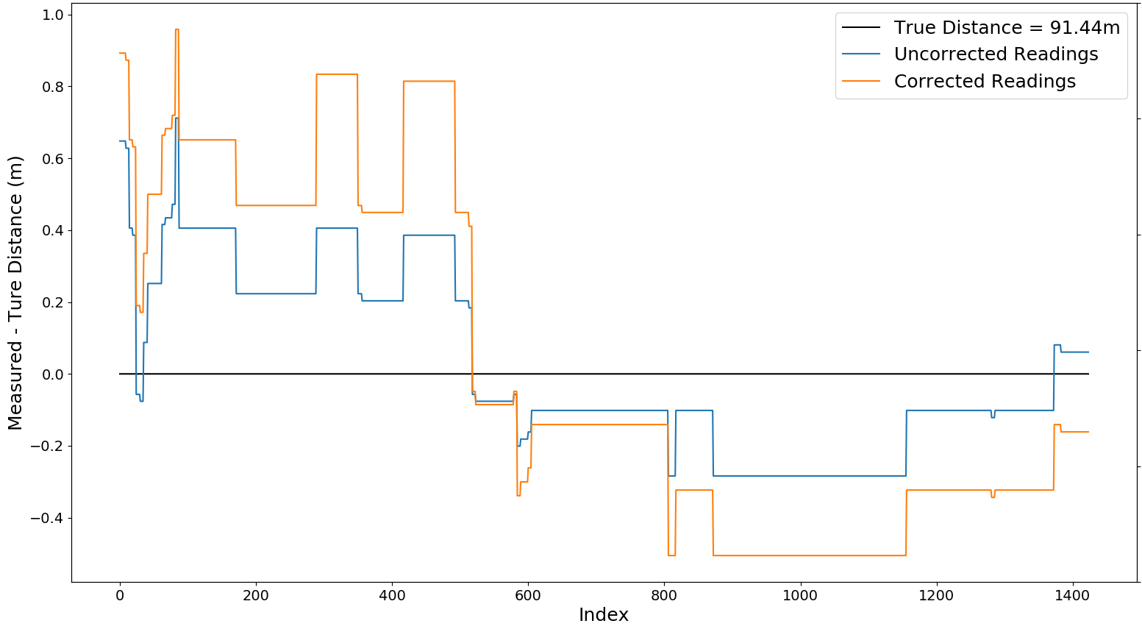
Current Progress: Cheap DGPS
‘100m Test’ True distance = 91.44m | Distance Delta (m) | MSE (m²) | σ (m)
Uncorrected | 1.3602 | 0.0632 | 0.2507
Corrected | 1.3602 | 0.2246 | 0.4734

Slide 10
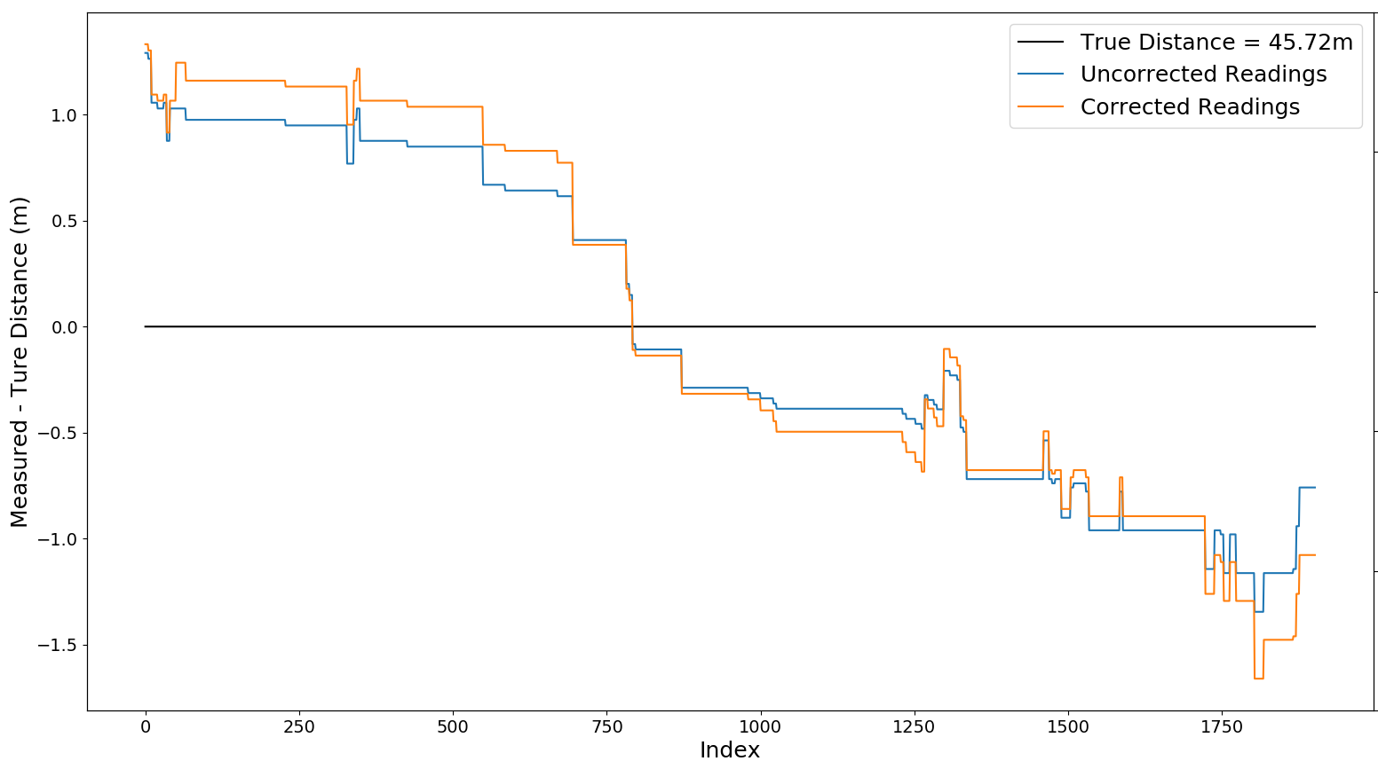
Current Progress: Cheap DGPS
‘50m Test’ True distance = 45.72m | Distance Delta (m) | MSE (m²) | σ (m)
Uncorrected | 2.8443 | 0.5862 | 0.7652
Corrected | 4.3862 | 0.7576 | 0.8703

Slide 11
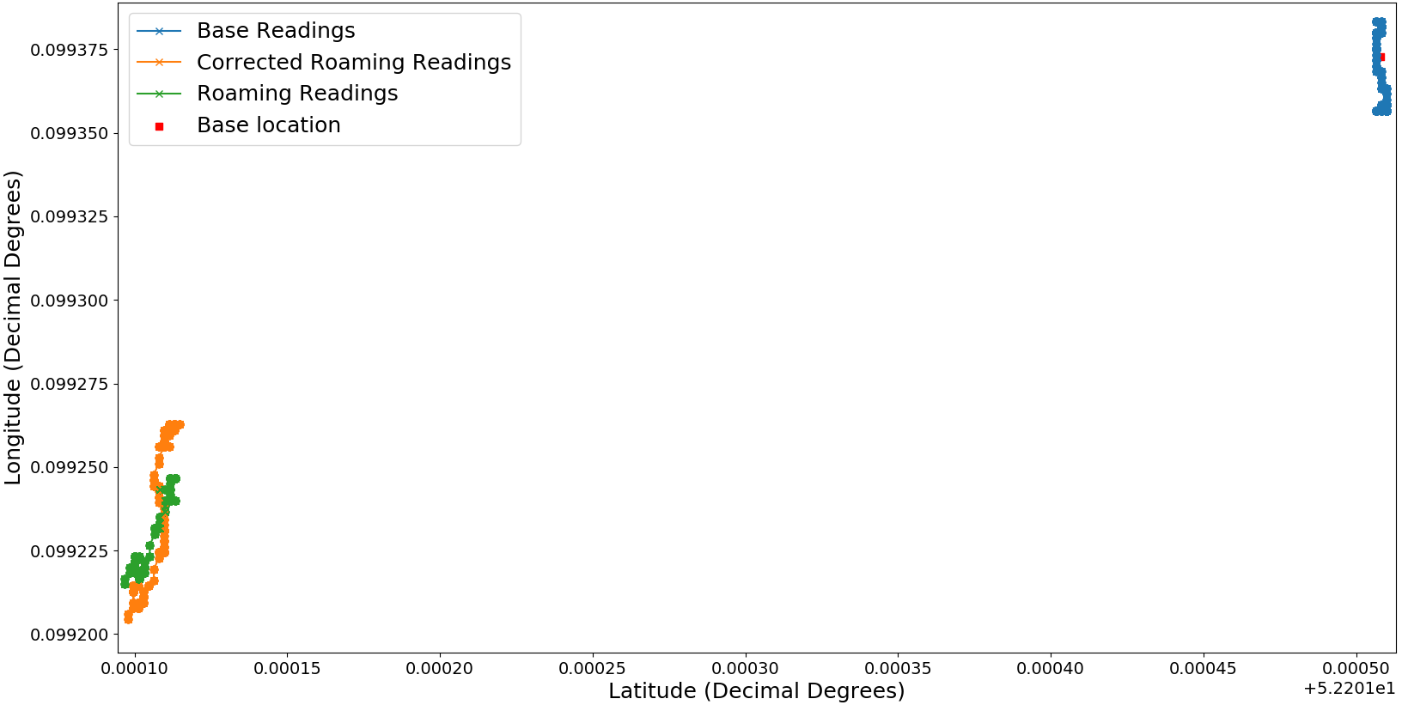
Current Progress: Cheap DGPS
Average Location
Variation
‘Uncorrected’
‘Corrected’ ≈ΣErrors
Latitude-Longitude plot for the 50m test

Slide 12
Current Progress: Altitude
Steady vs Temp
Walk about

Slide 13
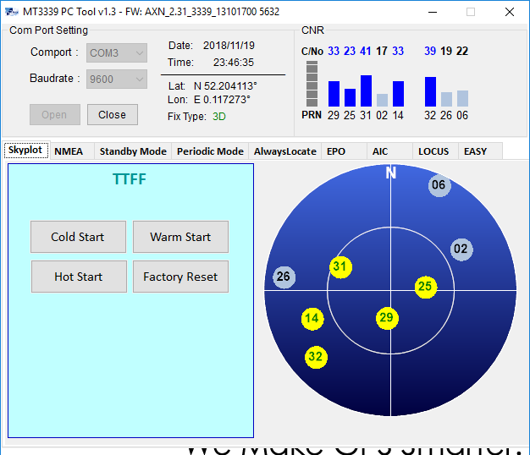
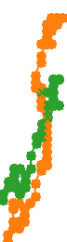
Take aways
Further Work
DGPS may not be the way to go
No drastic improvement
Sometimes makes it worse
Pressure sensor suitable for the roll
Investigate fix vs frequency
Look at a moving roaming station
Does satellites in view have an effect?
Uncorrected
Corrected

Slide 14
Aircraft Data Logger
IIB Project – Michaelmas Presentation

